Slide 1
Salary Prediction using Linear Regression
Using Machine Learning to Predict Employee Salary Based on Experience

Slide 2
Problem Statement
Predicting employee salaries is a common challenge for companies.
HR departments need to estimate the correct salary for new employees based on their experience, but manual estimation is often inaccurate and inconsistent.
There is a need for a simple, data-driven model that can help automate this prediction process and reduce errors, saving both time and resources for organizations.

Slide 3
Objective
The main objective of this project is to build a simple and accurate machine learning model using Linear Regression that can:
Analyze past salary records
Understand the relationship between years of experience and salary
Predict the salary of an employee based on their experience
Help organizations make smarter, data-based decisions
This project also aims to help beginners understand basic machine learning concepts.

Slide 4
Methodology
Data Collection
A dataset containing two columns — YearsExperience and Salary — was used.
Data Preprocessing
The dataset was checked for missing values and converted into suitable format.
Model Selection
Linear Regression was chosen because it is simple, fast, and perfect for numerical predictions.
Model Training
The model learns patterns from the dataset and creates a best-fit line.
Model Testing & Prediction
The trained model is tested to predict salary for different experience values.
Visualization
A graph is plotted to show the relationship between experience and salary.

Slide 5
Tools & Technologies
Programming Language:
Python
Libraries Used:
NumPy: Mathematical operations
Pandas: Data handling and analysis
Matplotlib: Creating graphs and visualizations
Scikit-learn: Machine learning model (Linear Regression)
Platform Used:
Google Colab Notebook (Cloud-based, no installation needed)
Algorithm:
Linear Regression — predicts continuous numerical values

Slide 6
Expected Output / Results
The Linear Regression model learns the relationship between experience and salary.
The system predicts salary accurately for new experience inputs.
A graph shows a straight line representing the salary trend.
HR teams or companies can use this model to estimate fair and consistent salaries.
The project demonstrates how machine learning can be used in simple business applications

Slide 7
Code Snippet 1 (Importing Libraries)
import pandas as pd
# Creating a simple salary dataset
data = {
"YearsExperience": [1, 2, 3, 4, 5],
"Salary": [35000, 40000, 45000, 50000, 60000]
}
df = pd.DataFrame(data)
df.to_csv("salary_data.csv", index=False)
Df

Slide 8
Code Snippet 2(Splitting Data & Training the Model)
import pandas as pd
from sklearn.model_selection import train_test_split
from sklearn.linear_model import LinearRegression
df = pd.read_csv("salary_data.csv")
X = df[["YearsExperience"]]
y = df["Salary"]
X_train, X_test, y_train, y_test = train_test_split(X, y, test_size=0.2)
model = LinearRegression()
model.fit(X_train, y_train)
model

Slide 9
Making Predictions
# Predict salary for the test data
predictions = model.predict(X_test)
output = pd.DataFrame({
"YearsExperience": X_test["YearsExperience"],
"Actual Salary": y_test,
"Predicted Salary": predictions
})
output

Slide 10
Graph Visualization Code
# Predict salary for the test data
predictions = model.predict(X_test)
output = pd.DataFrame({
"YearsExperience": X_test["YearsExperience"],
"Actual Salary": y_test,
"Predicted Salary": predictions
})
output

Slide 11
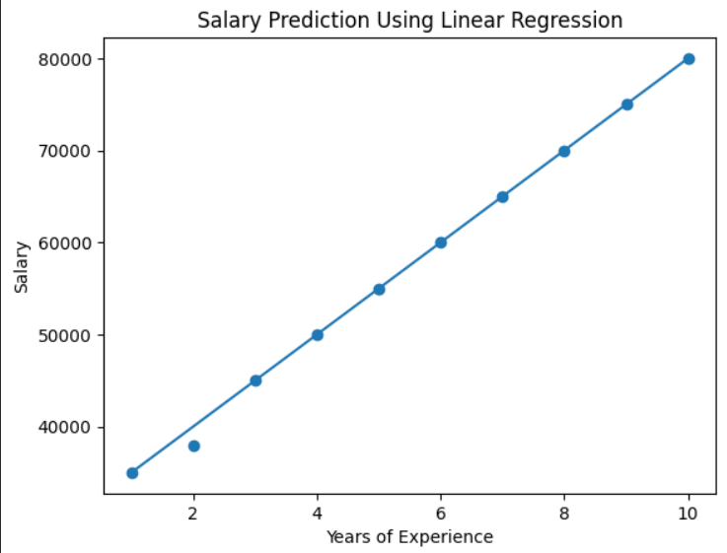

Graph

